Slide 1
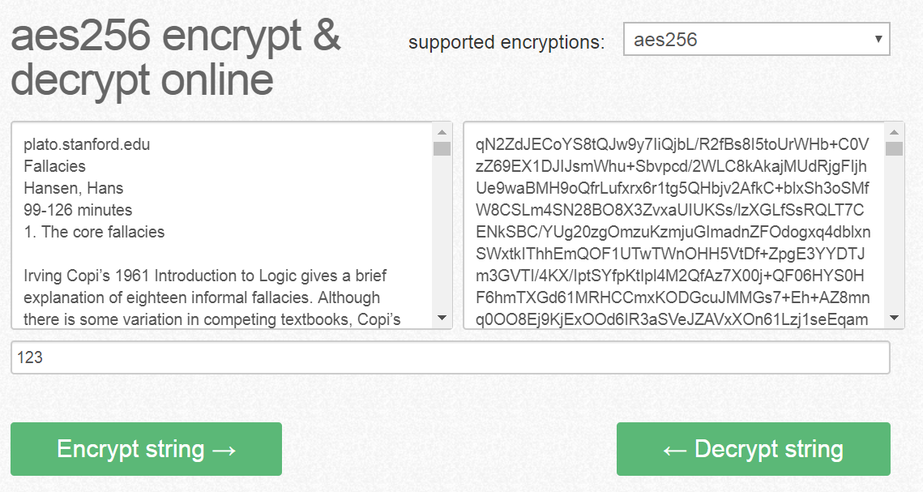

Slide 2
Compressed file txt

Slide 3
Hide it in image

Slide 4
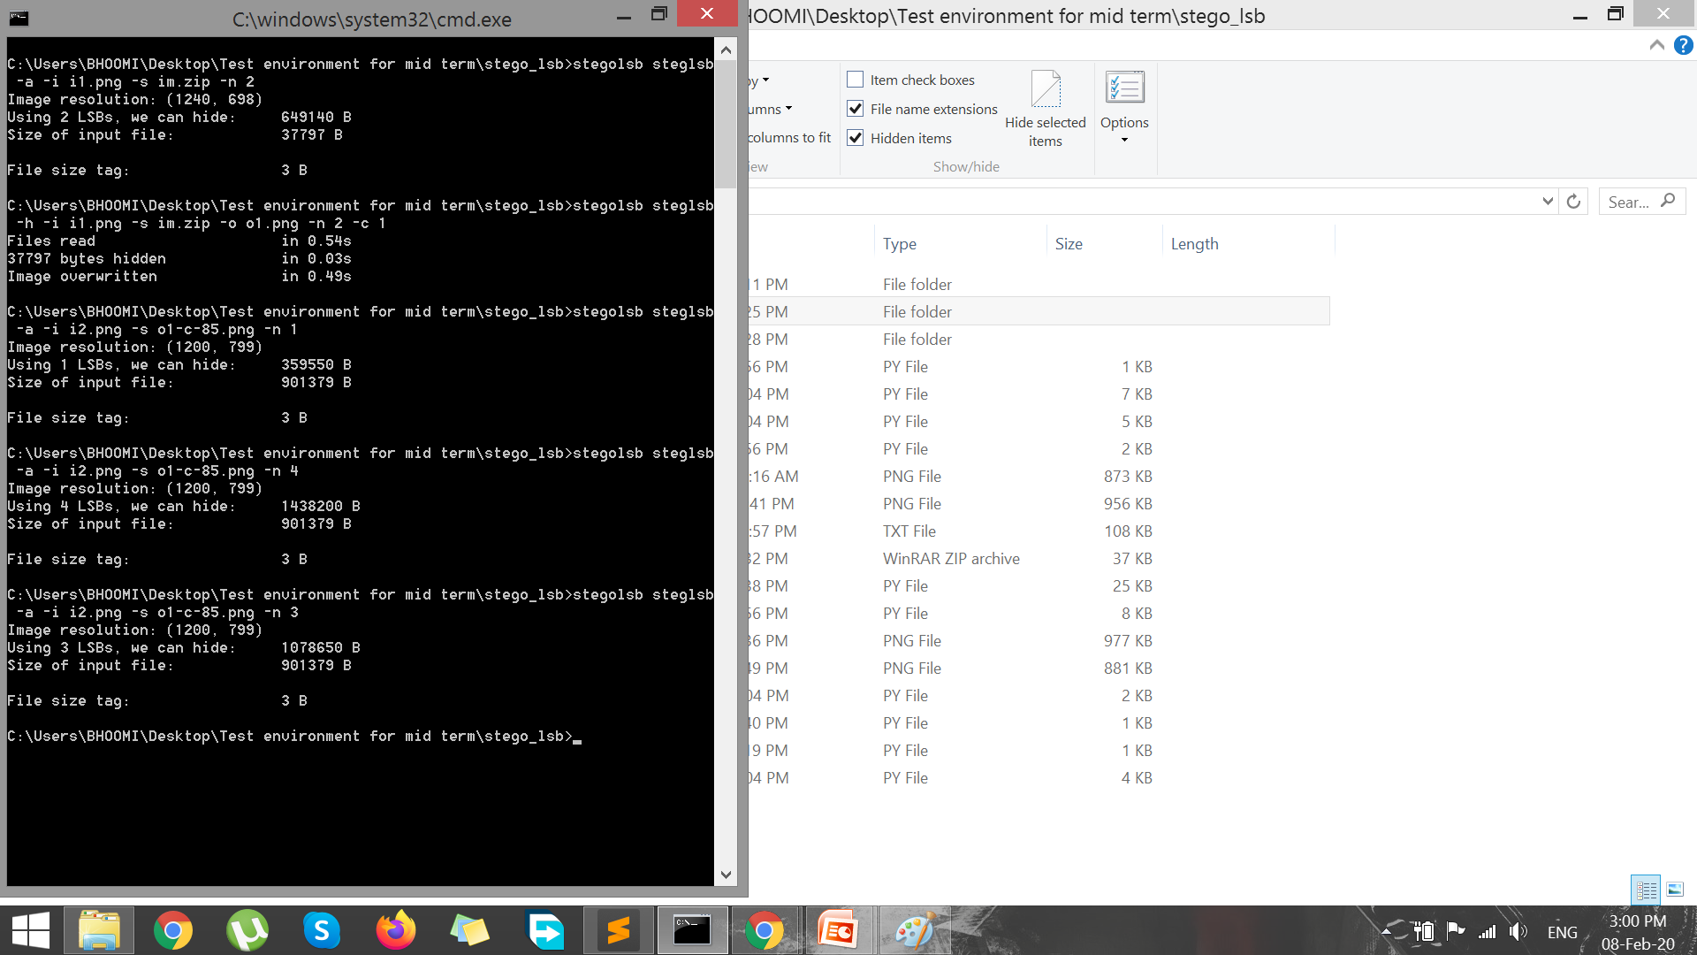
Compressing the image o2-c-85.zip
https://kraken.io/web-interface

Slide 5
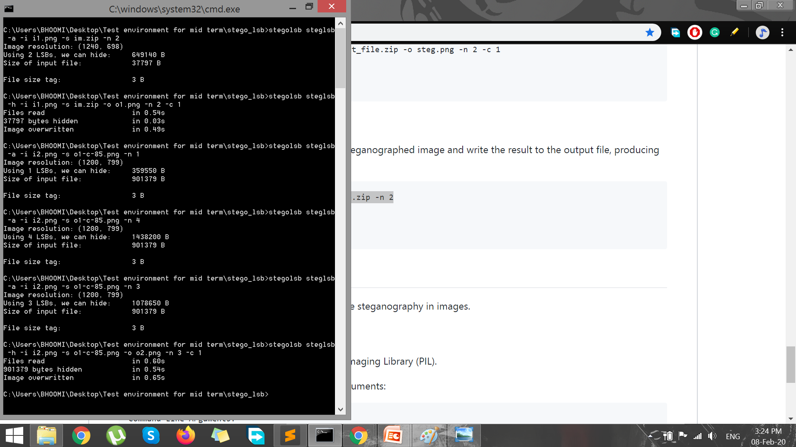
Adding image in i2 file

Slide 6
